Slide 1

AI-Powered PDF Q&A Systems: Revolutionizing Student Learning
Welcome to a new era of academic efficiency. This presentation will explore how AI-powered PDF Q&A systems are transforming how students interact with information, making learning more intuitive and effective.

Slide 2



The Student Challenge: Overwhelmed by Information
Information Overload
Time-Consuming
Unanswered Questions
Students navigate vast quantities of textbooks, research papers, and lecture notes daily.
Traditional reading methods are often inefficient and time-consuming, hindering deep understanding.
Finding specific answers or clarifying concepts within lengthy documents remains a significant hurdle.
The core question is: How can AI transform study habits and significantly boost learning outcomes?

Slide 3
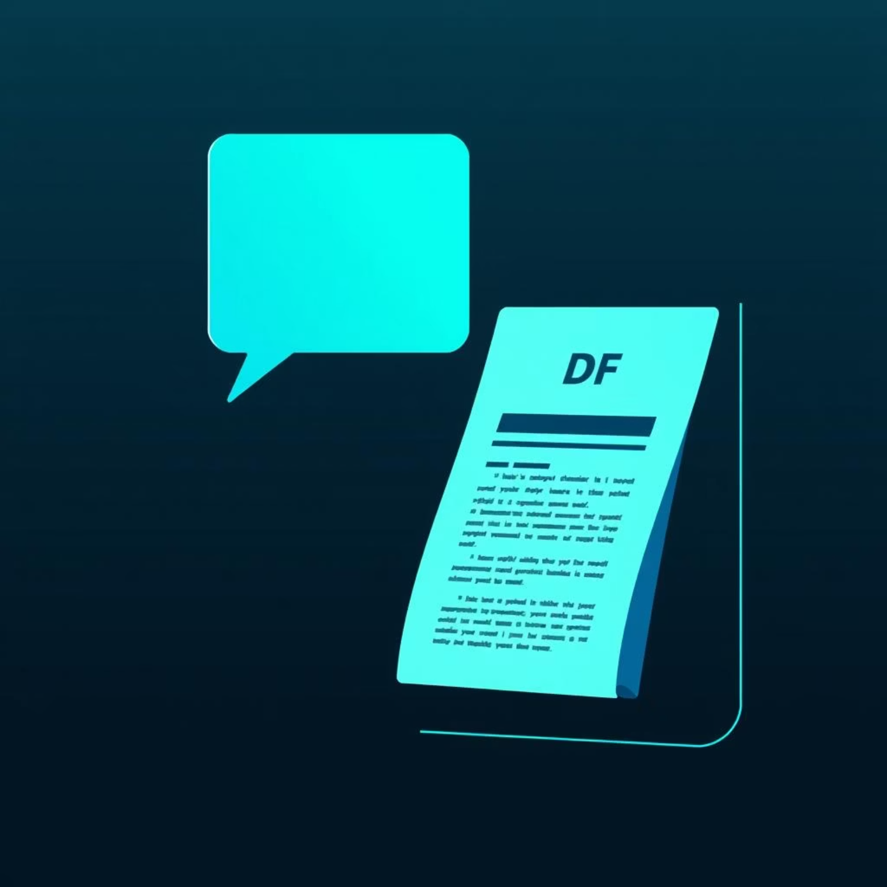
Meet ChatPDF: The AI Tutor for Your PDFs
Upload any PDF and instantly ask questions in natural language.
Answers come with precise citations linked directly to the source pages within the document.
Trusted by millions of students and researchers worldwide for its accuracy and ease of use.
Enhances comprehension and retention by providing context-rich responses.

Slide 4


How It Works: AI Understands Your Documents
Intelligent Retrieval
Semantic Mapping
The system quickly locates and extracts relevant information to answer questions or summarize complex sections with precision.
Advanced AI algorithms build a comprehensive semantic map of your PDF content, understanding relationships between concepts.
Contextual Responses
Multi-File Integration
Provides answers that are not just accurate, but also rich in context, helping you grasp the bigger picture.
Supports multi-file chats, allowing you to integrate information from multiple study materials for holistic understanding.

Slide 5

Real Student Benefits: Study Smarter, Not Harder
95%
80%
100%
Reading Time Saved
Automated Content
Global Accessibility
Pinpoint exact answers, reducing reading time by up to 95% (Docalysis data).
Generates summaries, flashcards, and practice questions automatically (StudyPDF, Mindgrasp).
Supports multiple languages and file types, ensuring accessibility for students worldwide.
These tools empower students to focus on understanding rather than endless searching.

Slide 6

Beyond PDFs: Integrated Learning Ecosystems
Content Conversion: Platforms like Mindgrasp convert diverse learning materials (lectures, videos, notes) into AI-powered quizzes and flashcards.
Personalized Tutors: AI tutors provide instant, personalized homework help and exam preparation, accessible anytime, anywhere.
Seamless Integration: Chrome extensions enable seamless study and information retrieval across Learning Management Systems (LMS) and web resources.
Adaptive Learning: AI adapts to individual learning styles, offering customized pathways to mastery.

Slide 7




Security & Privacy: Safe AI Assistance
Document Privacy
Data Handling
No Model Training
Leading tools like Adobe Acrobat AI and ChatPDF ensure robust document privacy and data security.
Uploaded files are either deleted after use or protected under strict compliance regulations (e.g., GDPR, Microsoft Azure OpenAI).
Crucially, user content is never used to train AI models without explicit consent, ensuring your data remains yours.
Rest assured, these tools prioritize your academic integrity and personal information.

Slide 8

Case Study: From Overwhelmed to A+ Student
Meet Sarah:
A university student struggling to keep up with vast amounts of research papers and textbooks.
The Transformation:
Cut study time by 70% using ChatPDF for quick answers and Mindgrasp for automated summaries and quizzes.
Transformed dense research papers into clear, digestible summaries and interactive quizzes.
Improved her exam scores significantly and experienced a noticeable reduction in study-related stress.

Slide 9
The Future of Learning: AI-Powered PDFs as Essential Study Tools
01
02
03
Standardization
Continuous Improvement
Empowering Mastery
AI Q&A systems will become a standard and indispensable part of education worldwide, integrated into curricula.
Ongoing advancements in AI will lead to even greater accuracy, interactivity, and personalization in learning tools.
Students will be empowered to master complex subjects faster and achieve deeper comprehension, unlocking new academic potential.

Slide 10


Ready to Transform Your Study Experience?
Embrace AI-powered PDF Q&A tools today to save time, deepen your understanding, and excel academically. The future of learning is here—are you ready to chat with your PDFs?

